Slide 1

INFM600 Team Project
GRADUATE STUDENT PORTAL
Team 1: Becky Jones, Jonathan Ortega, Nidhi Nambiar,
Scott Mobarry, Rajeevan Madabushi, and Ya-Ting Yang.
Notes:
Becky
https://ischool.umd.edu/wp-content/uploads/Hornbake-thumbnail.png

Slide 2

Overview
Portal via ELMS-Canvas for Graduate Assistants and Graders to
LEARN and COMMUNICATE
with University’s Human Resources, Supervisors, and Peer GAs and Graders
Notes:
Becky
https://www.google.com/url?sa=i&url=https%3A%2F%2Felms.umd.edu%2F&psig=AOvVaw1FFAdFrKKUIKPr-k9O9TVT&ust=1670613390237000&source=images&cd=vfe&ved=0CA8QjRxqFwoTCJCKu4Xe6vsCFQAAAAAdAAAAABAI

Slide 3

Information Need
Novice Graduate Assistants or Graders
Onboarding Process
Communication
Notes:
Becky
https://www.google.com/url?sa=i&url=https%3A%2F%2Fischool.umd.edu%2F&psig=AOvVaw3U8OjJ-vbZ-b5Vw9zK4arv&ust=1670613835379000&source=images&cd=vfe&ved=0CA8QjRxqFwoTCLDA_Mjg6vsCFQAAAAAdAAAAABAS

Slide 4

Perspective
After interviewing five supervisors, GAs, graders…
“It [portal] would be great for GAs and Graders to communicate with each other to standardize the content in the required classes.”
“It [portal] would be really useful to know how the previous GA’s and Graders worked on the same/similar assignments…”
“Receiving feedback about the task would certainly be valuable so that we may get a sense of how other graders are evaluating the assignment. And if we have any questions or concerns, we may occasionally discuss them with the other graders before contacting the professor.”
Notes:
Becky
https://www.google.com/url?sa=i&url=http%3A%2F%2Fclipart-library.com%2Fbusiness-men-cliparts.html&psig=AOvVaw3u5sJ6yTVGxt8umIvtMFkN&ust=1671052322217000&source=images&cd=vfe&ved=0CA8QjRxqFwoTCODsv5TB9_sCFQAAAAAdAAAAABAD

Slide 5

Vision
Long-Overdue Portal for iSchool
Ensure Sustainability through Incentives for GAs and Graders to Continue Participating
Notes:
Becky
https://freerangestock.com/sample/38792/light-bulb-idea-vector-illustration.jpg

Slide 6



Information Use
STEP 1 STEP 2 STEP 3
DATA COLLECTION
DATA PROCESSING
DATA ANALYSIS & STORAGE
Our team interviewed few TA’s, Graders and Faculty members of the iSchool and gathered information about the gaps existing in the current onboarding system for new joiners, so that we can bridge this gap and ensure a smooth process.
For our Graduate Student Portal we decided to build the design within the university’s learning management system i.e., ELMS
ELMS already has few built-in functionalities to track users activity through course analytics.
Here, administrators can use this information to track student participation, page views, etc.
The portal uses relational database to store all the data.
Notes:
Nidhi

Slide 7
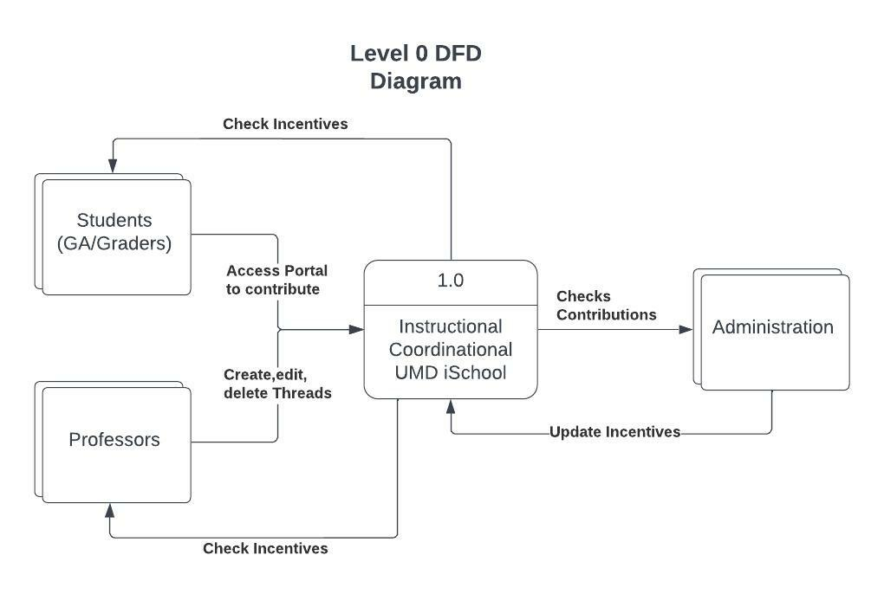
Level 0 DFD
Notes:
Nidhi
This is a basic understanding of how our system will operated…See GitHub for Level 1

Slide 8
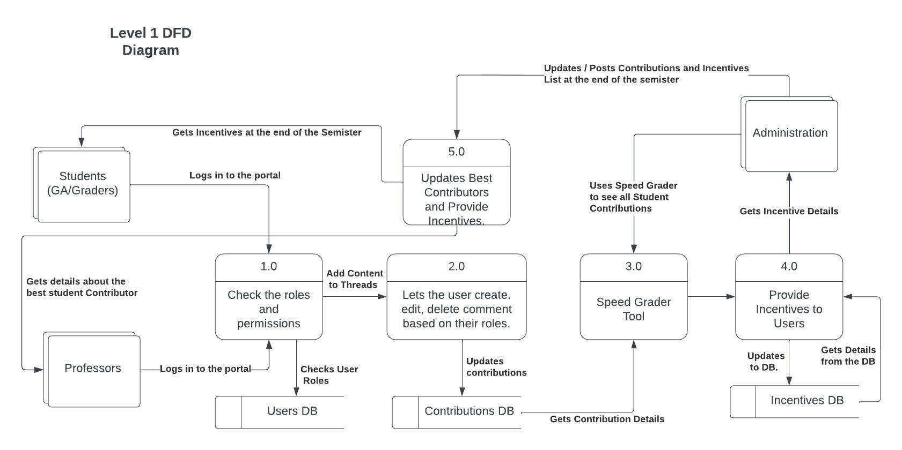
Level 1 DFD
Notes:
Nidhi

Slide 9
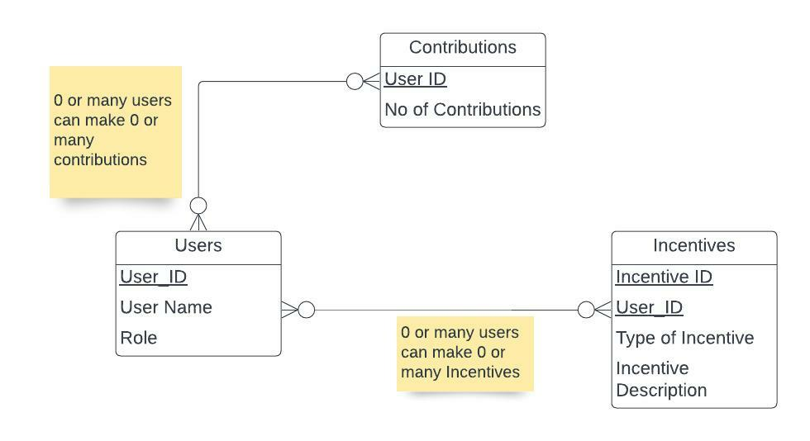
Entity Relationship Diagram
Notes:
Nidhi

Slide 10

Functionality
Main functionalities of the portal:
Provides information about the onboarding process for newly appointed GAs and graders
Stack Overflow like Discussion board that allows collaboration amongst current and previous GAs and graders
Providing incentives to GAs and graders who contribute towards the discussion threads
Notes:
Nidhi

Slide 11
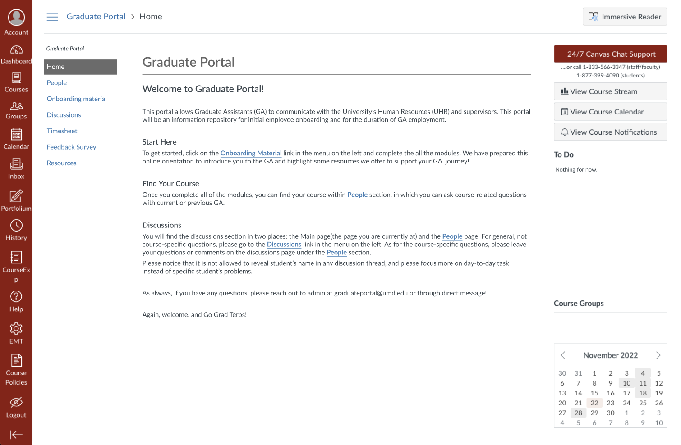
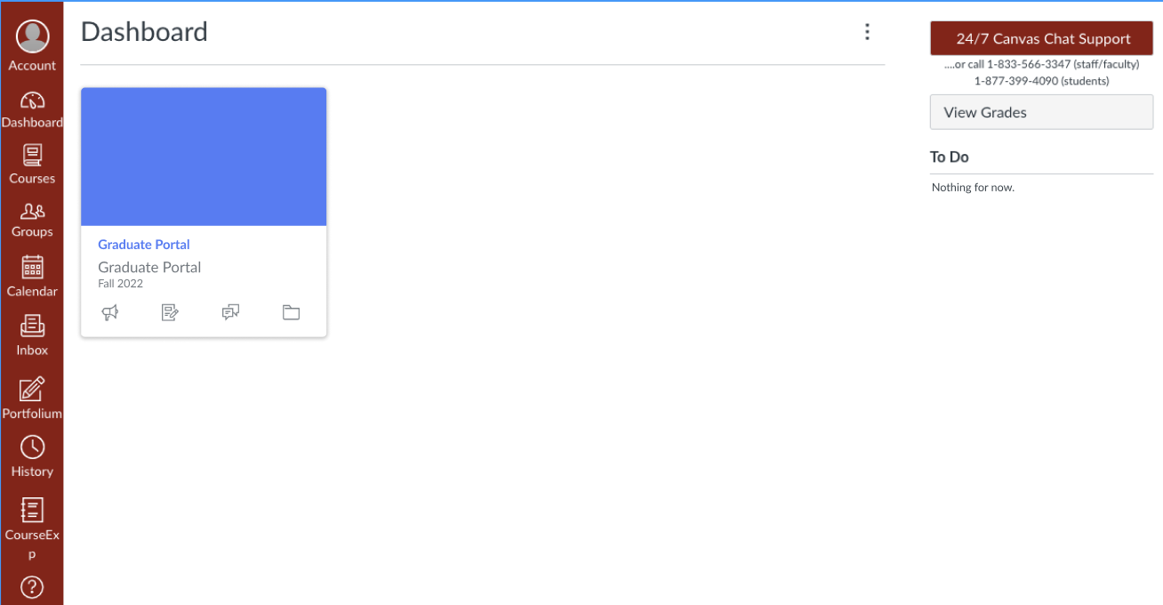
At a Glance…
A preview of the wireframe layouts for our Graduate Student Portal…
Notes:
Nidhi

Slide 12
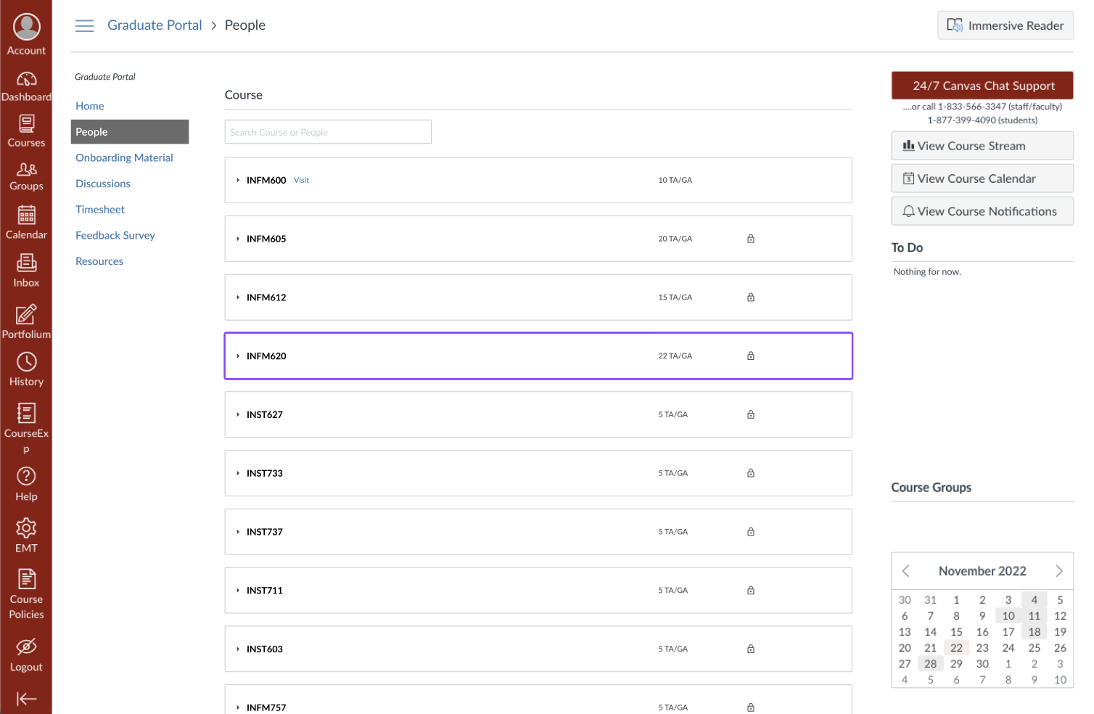
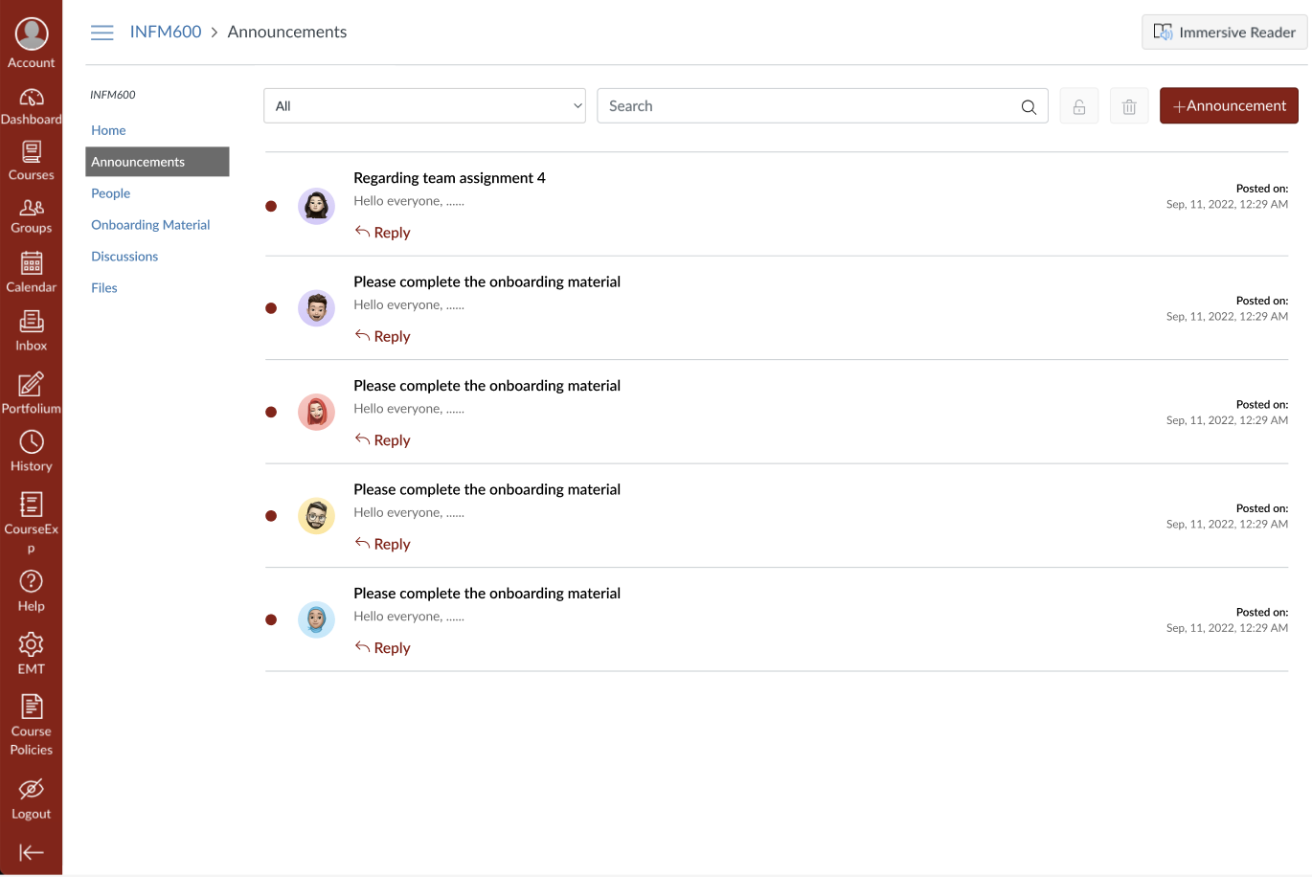

Slide 13
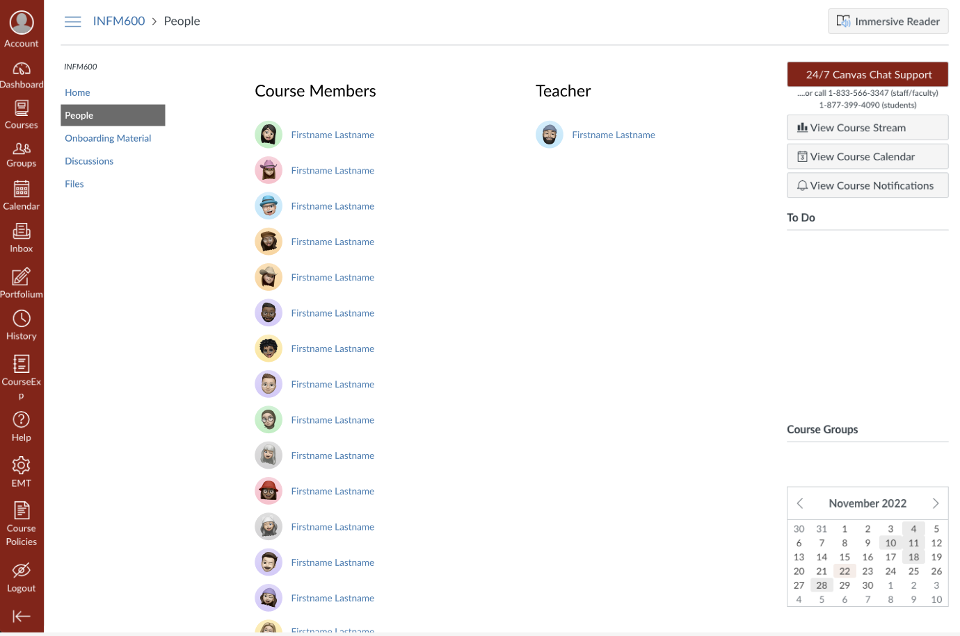
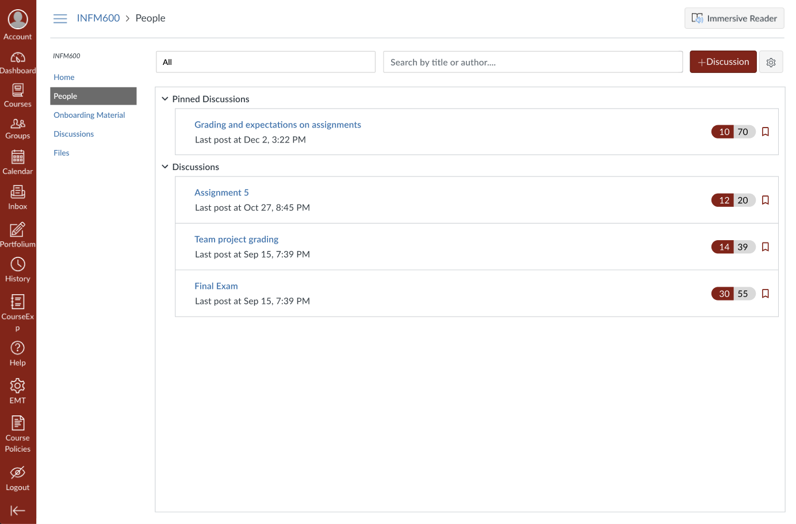

Slide 14
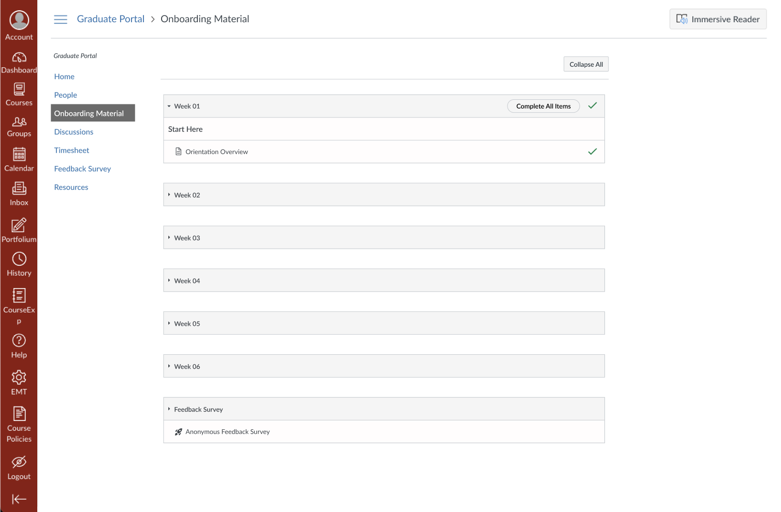

Slide 15
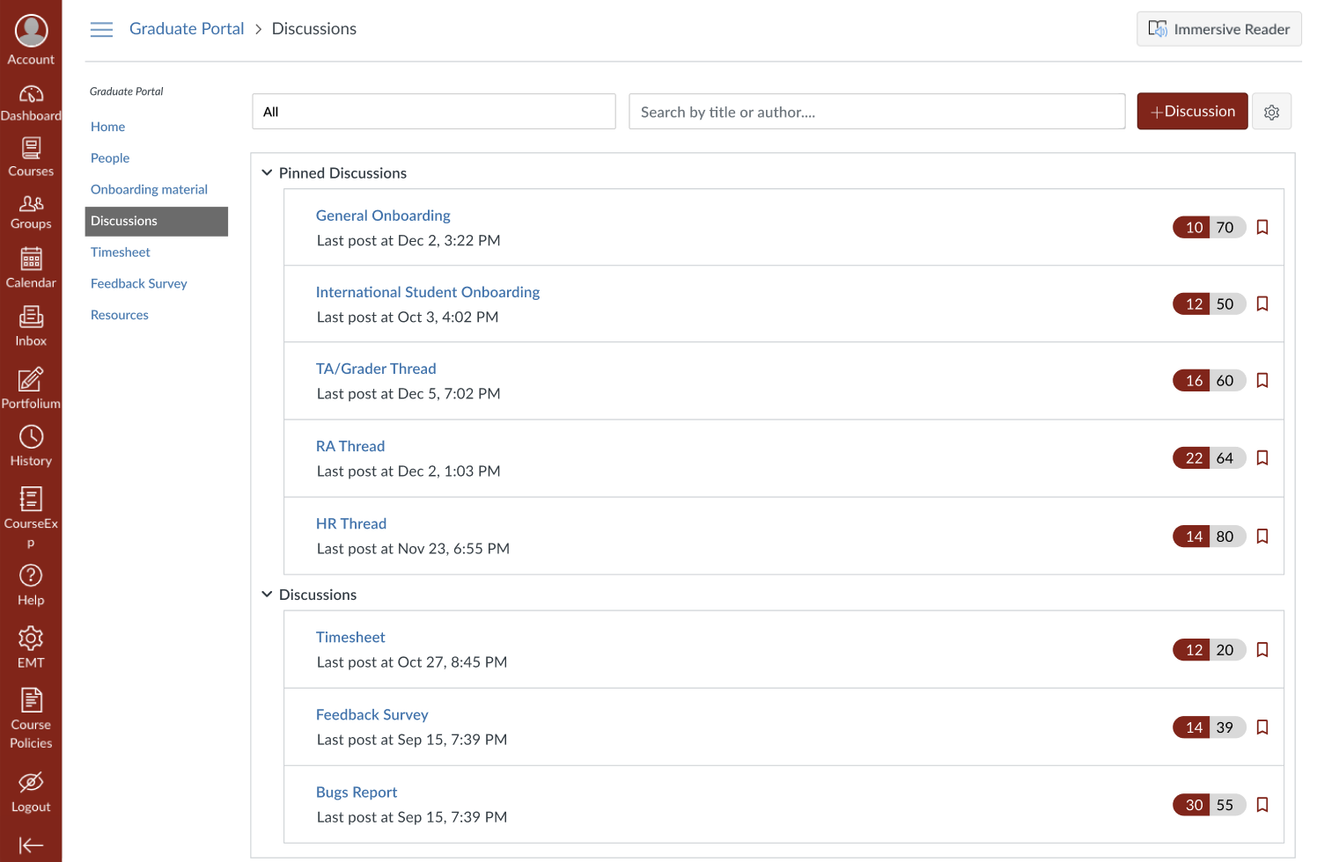
Notes:
Nidhi

Slide 16
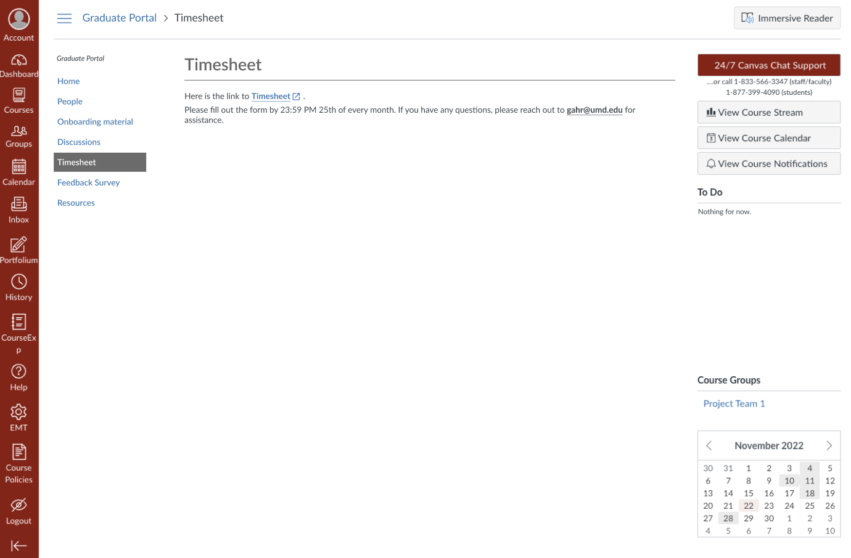
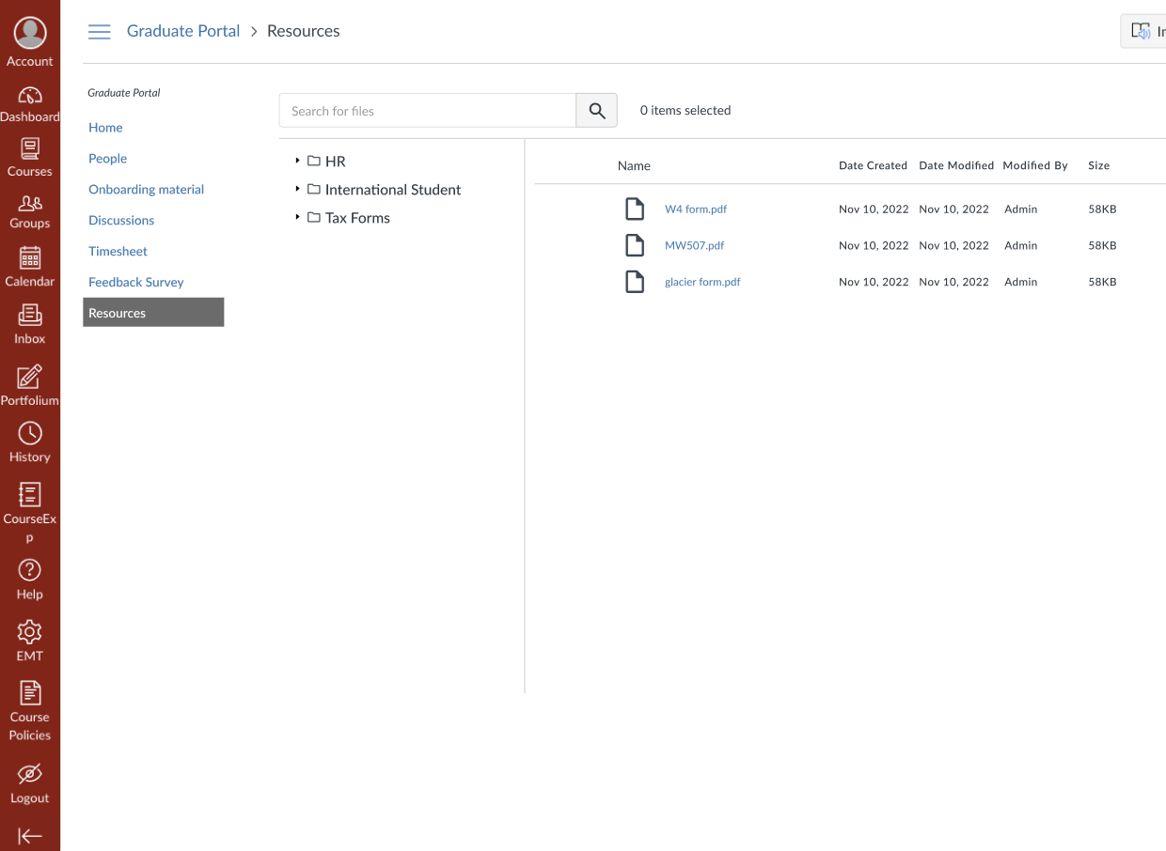

Slide 17

Impact
What impacts does this service provide?
Confidence for GAs
Confidence for professors
Sense of unity and cohesion
Notes:
Jonathan:
Confidence for GAs in terms of having a community to support them and rely on

Slide 18

Limitation
Where are we limited?
Monitoring of spam responses
Filtering users/ registered GAs
Notes:
Jonathan
Filtering/ spam responses
Unregistering users that do not want to be in the course/ portal anymore

Slide 19

Future Ideas
Suggest this design to other departments at UMD
Additional interviews and statements from faculty
Possible interviews from students
Notes:
Jonathan:
Work with other group to have a cohesive system
More interviews to have a more general idea of wants/ needs

Slide 20
Thank You!
Notes:
Jonathan

Slide 21
References
Notes:
Jonathan

